Slide 1
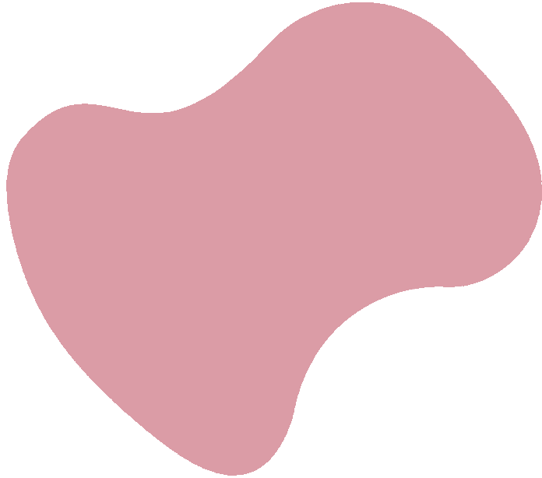
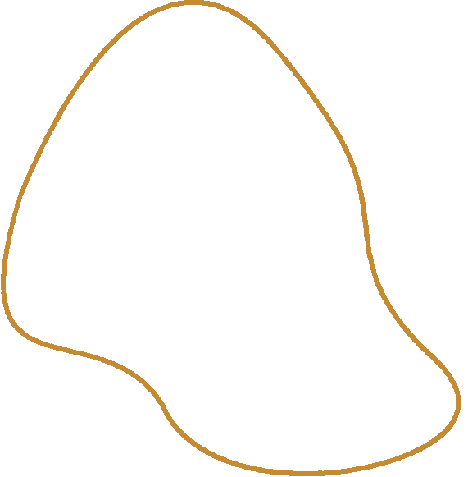

Physio-Therapy
AI-Powered
By: Moaz Mahmoud 227374

Slide 2
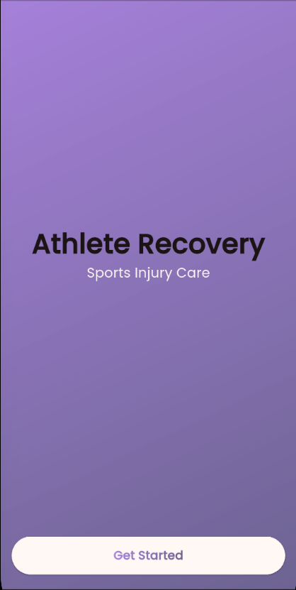
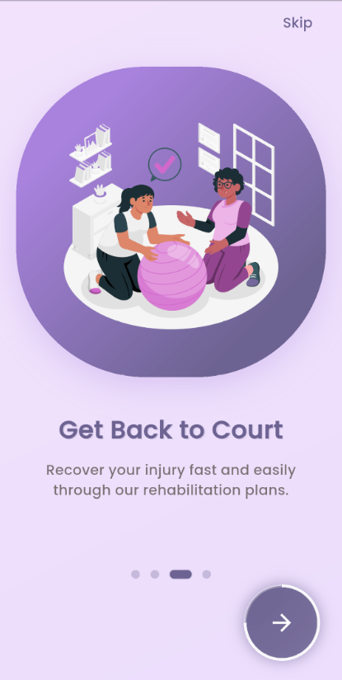
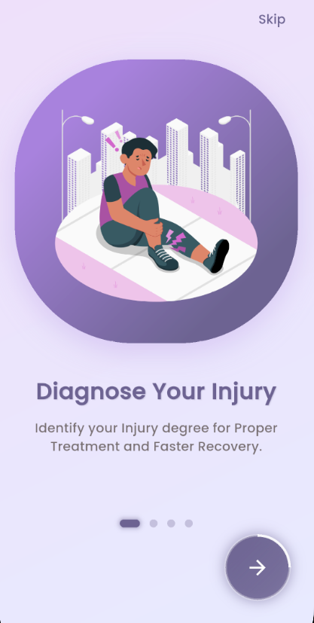
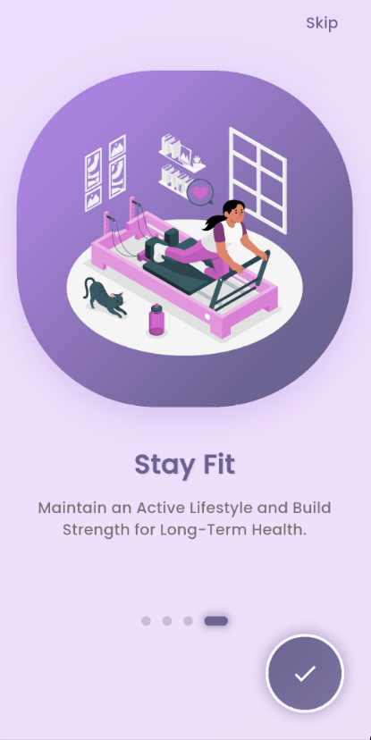
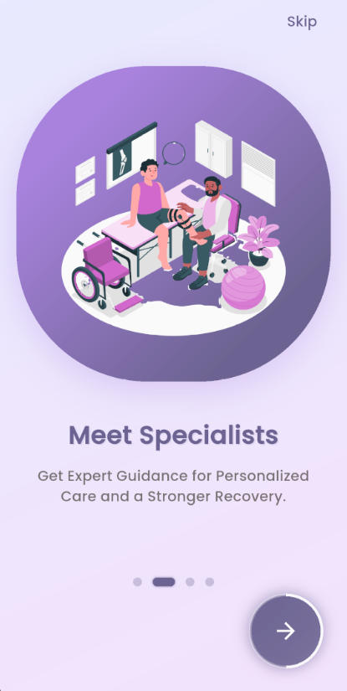

Agenda
Topics Covered
1
Introduction
2
Problem Statement
3
Proposed Solution
4
Conclusion
5
Future Work

Slide 3
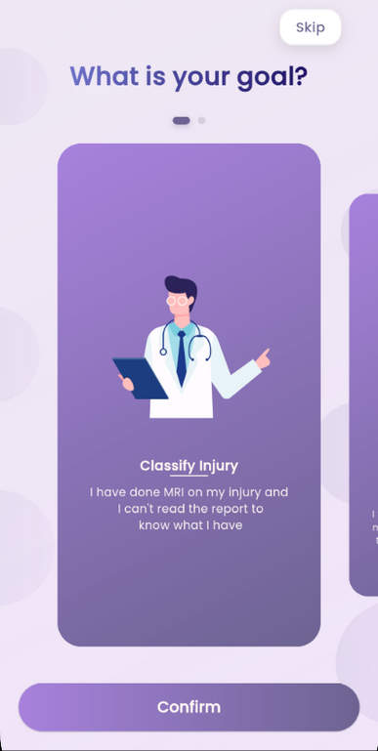
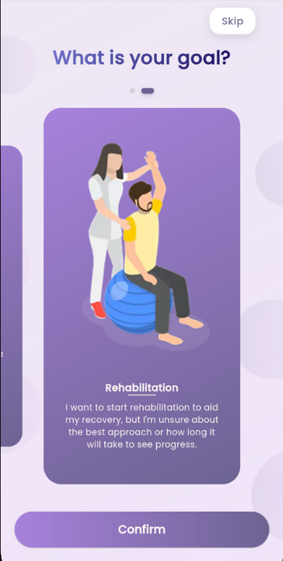
Introduction
  Physical therapy demands continuous connection between patients and providers
  Interruptions in care can delay recovery and increase the risk of reinjury
  Traditional rehab struggles with care gaps
  The use of AI, ML, and computer vision to maintain care continuity
  Ensuring verified medical supervision, 24/7 accessibility, and enhanced patient engagement.

Slide 4
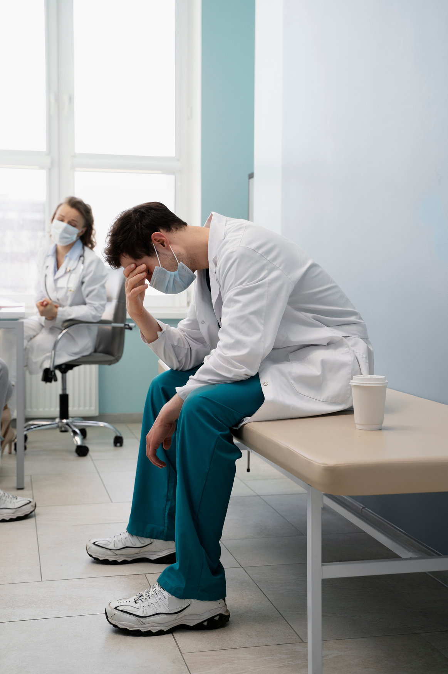
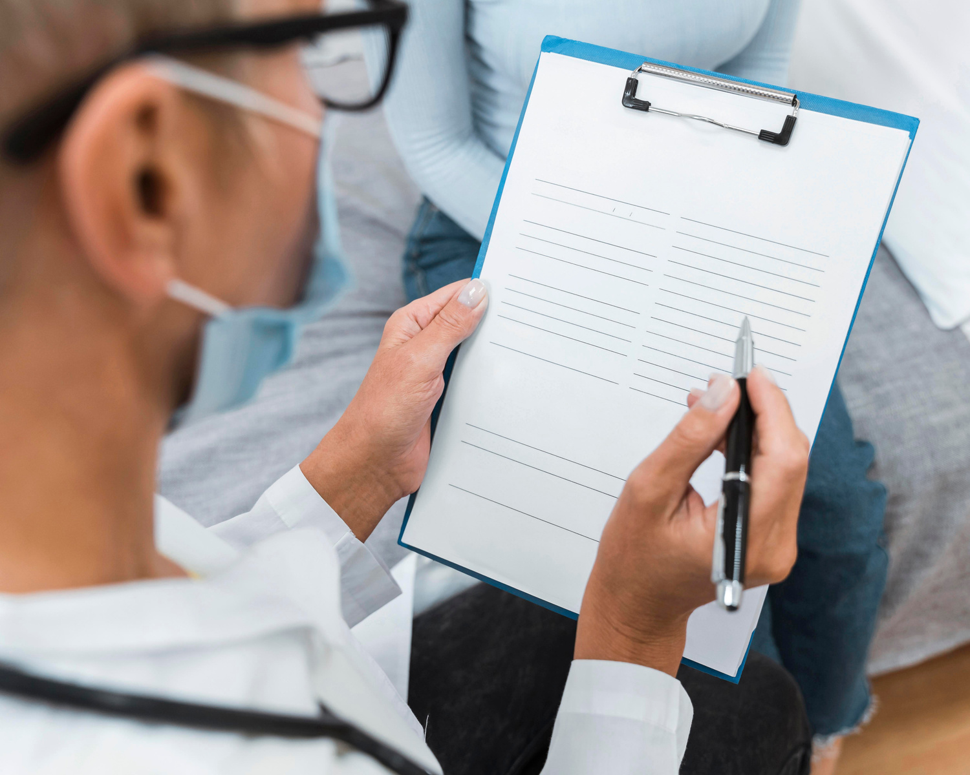
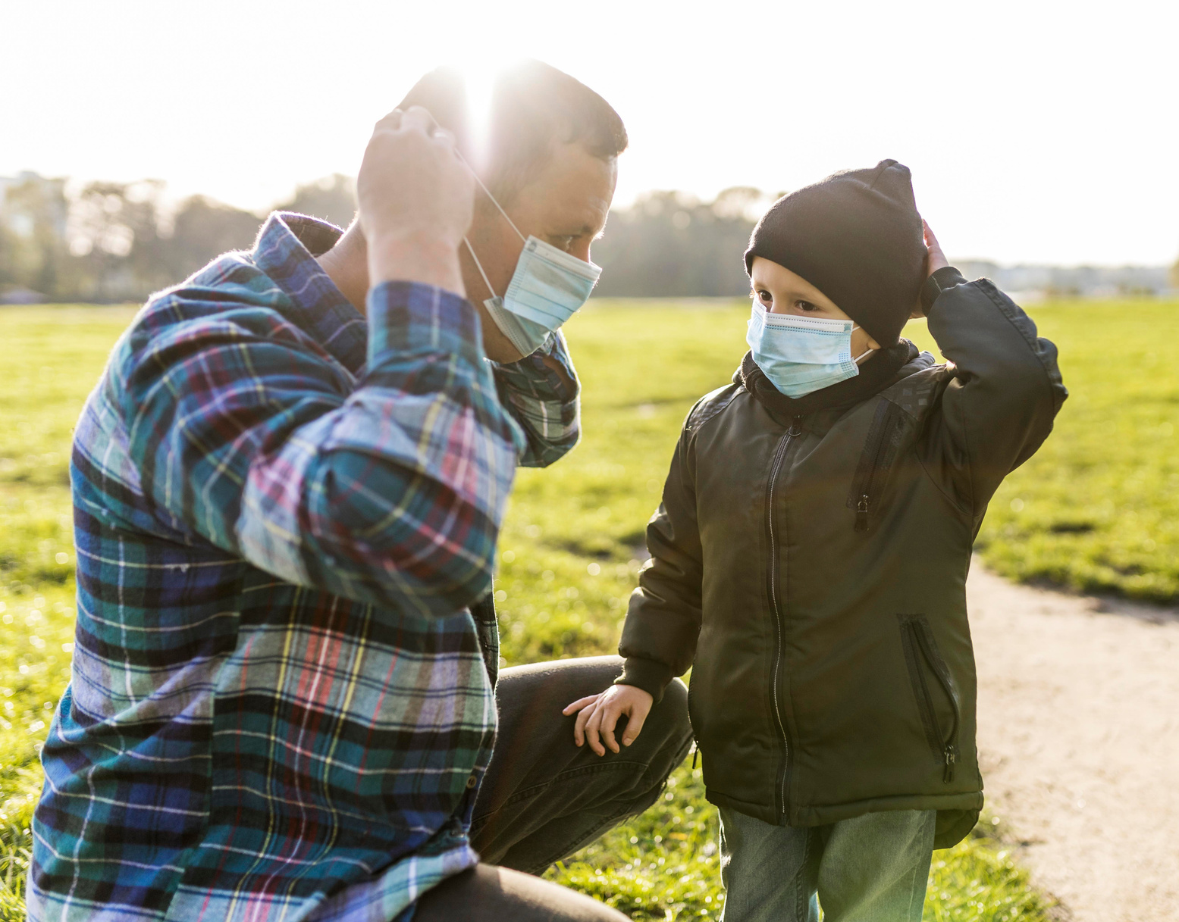
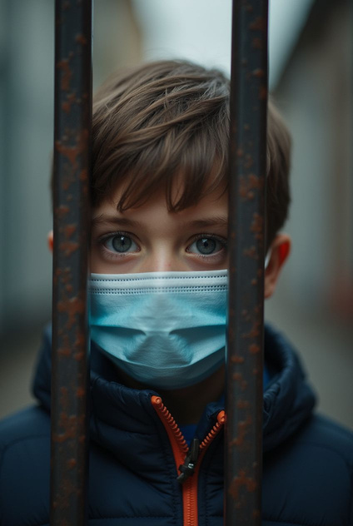
Problem Statement
Lack of Continuous Support
Traditional Rehab Issue
Vagueness of Medical Reports
Rural Areas
isolation
Patients are left unsupervised between sessions and vacations
Traditional rehab models fail during and public crises.
Patients struggle to understand Medical reports terms
Rural areas face limited access to specialized physical therapy

Slide 5

Related Work

Slide 6
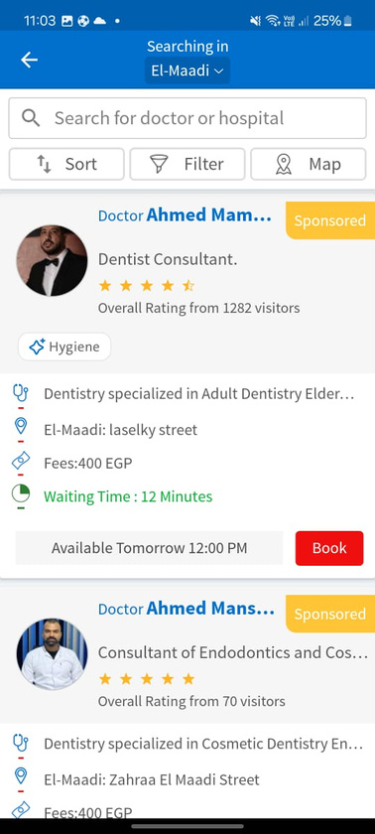
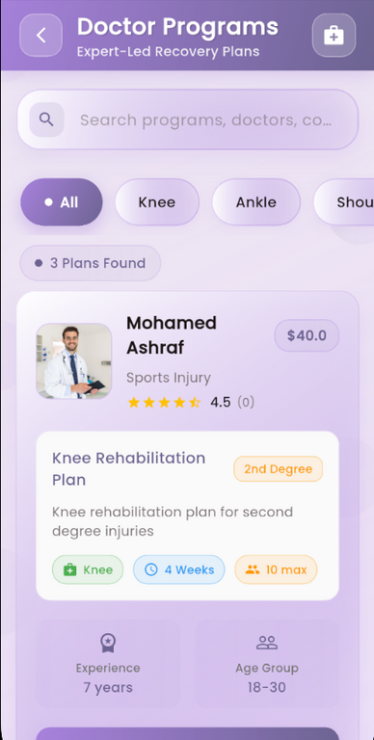
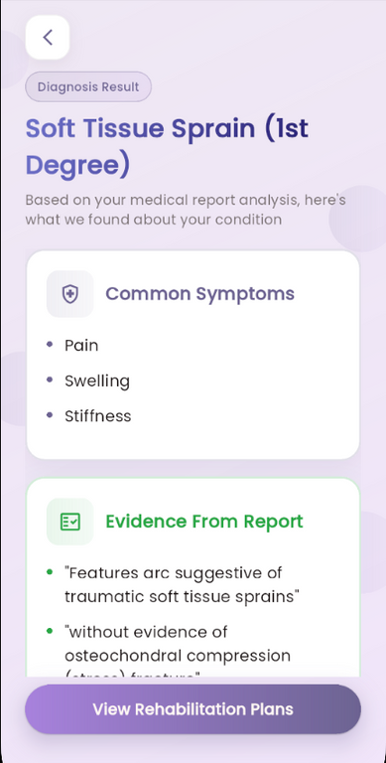
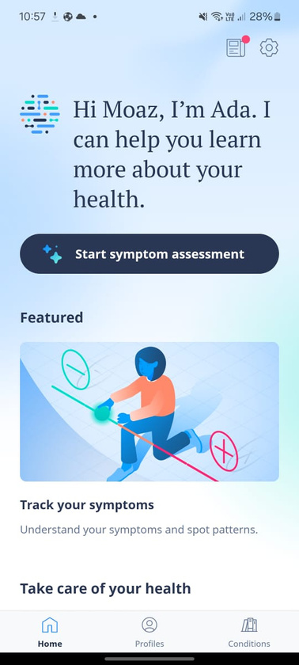
Similar Applications
Vezeeta
Physiotherapy
Ada
Connecting with Doctors
Symptom Classification

Slide 7
Proposed Solution

Slide 8


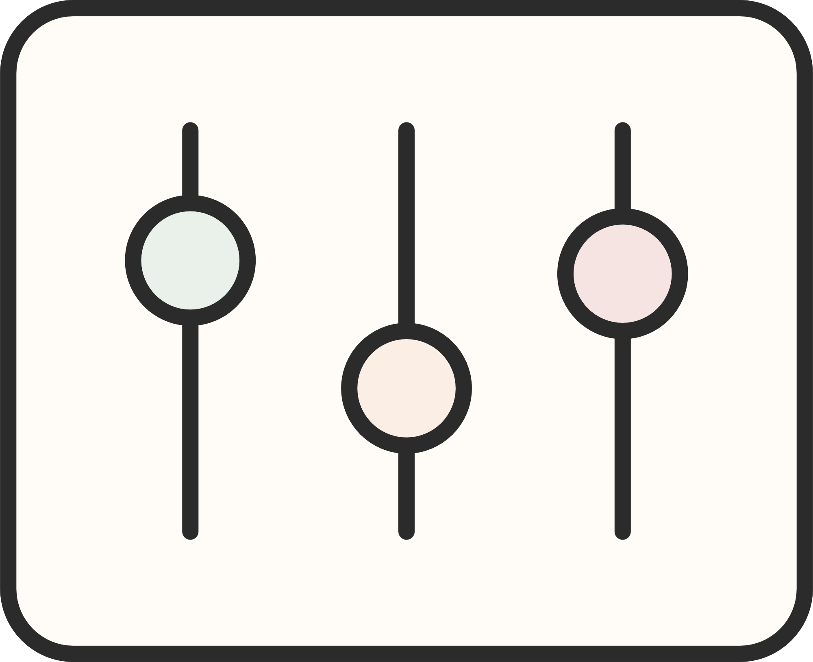
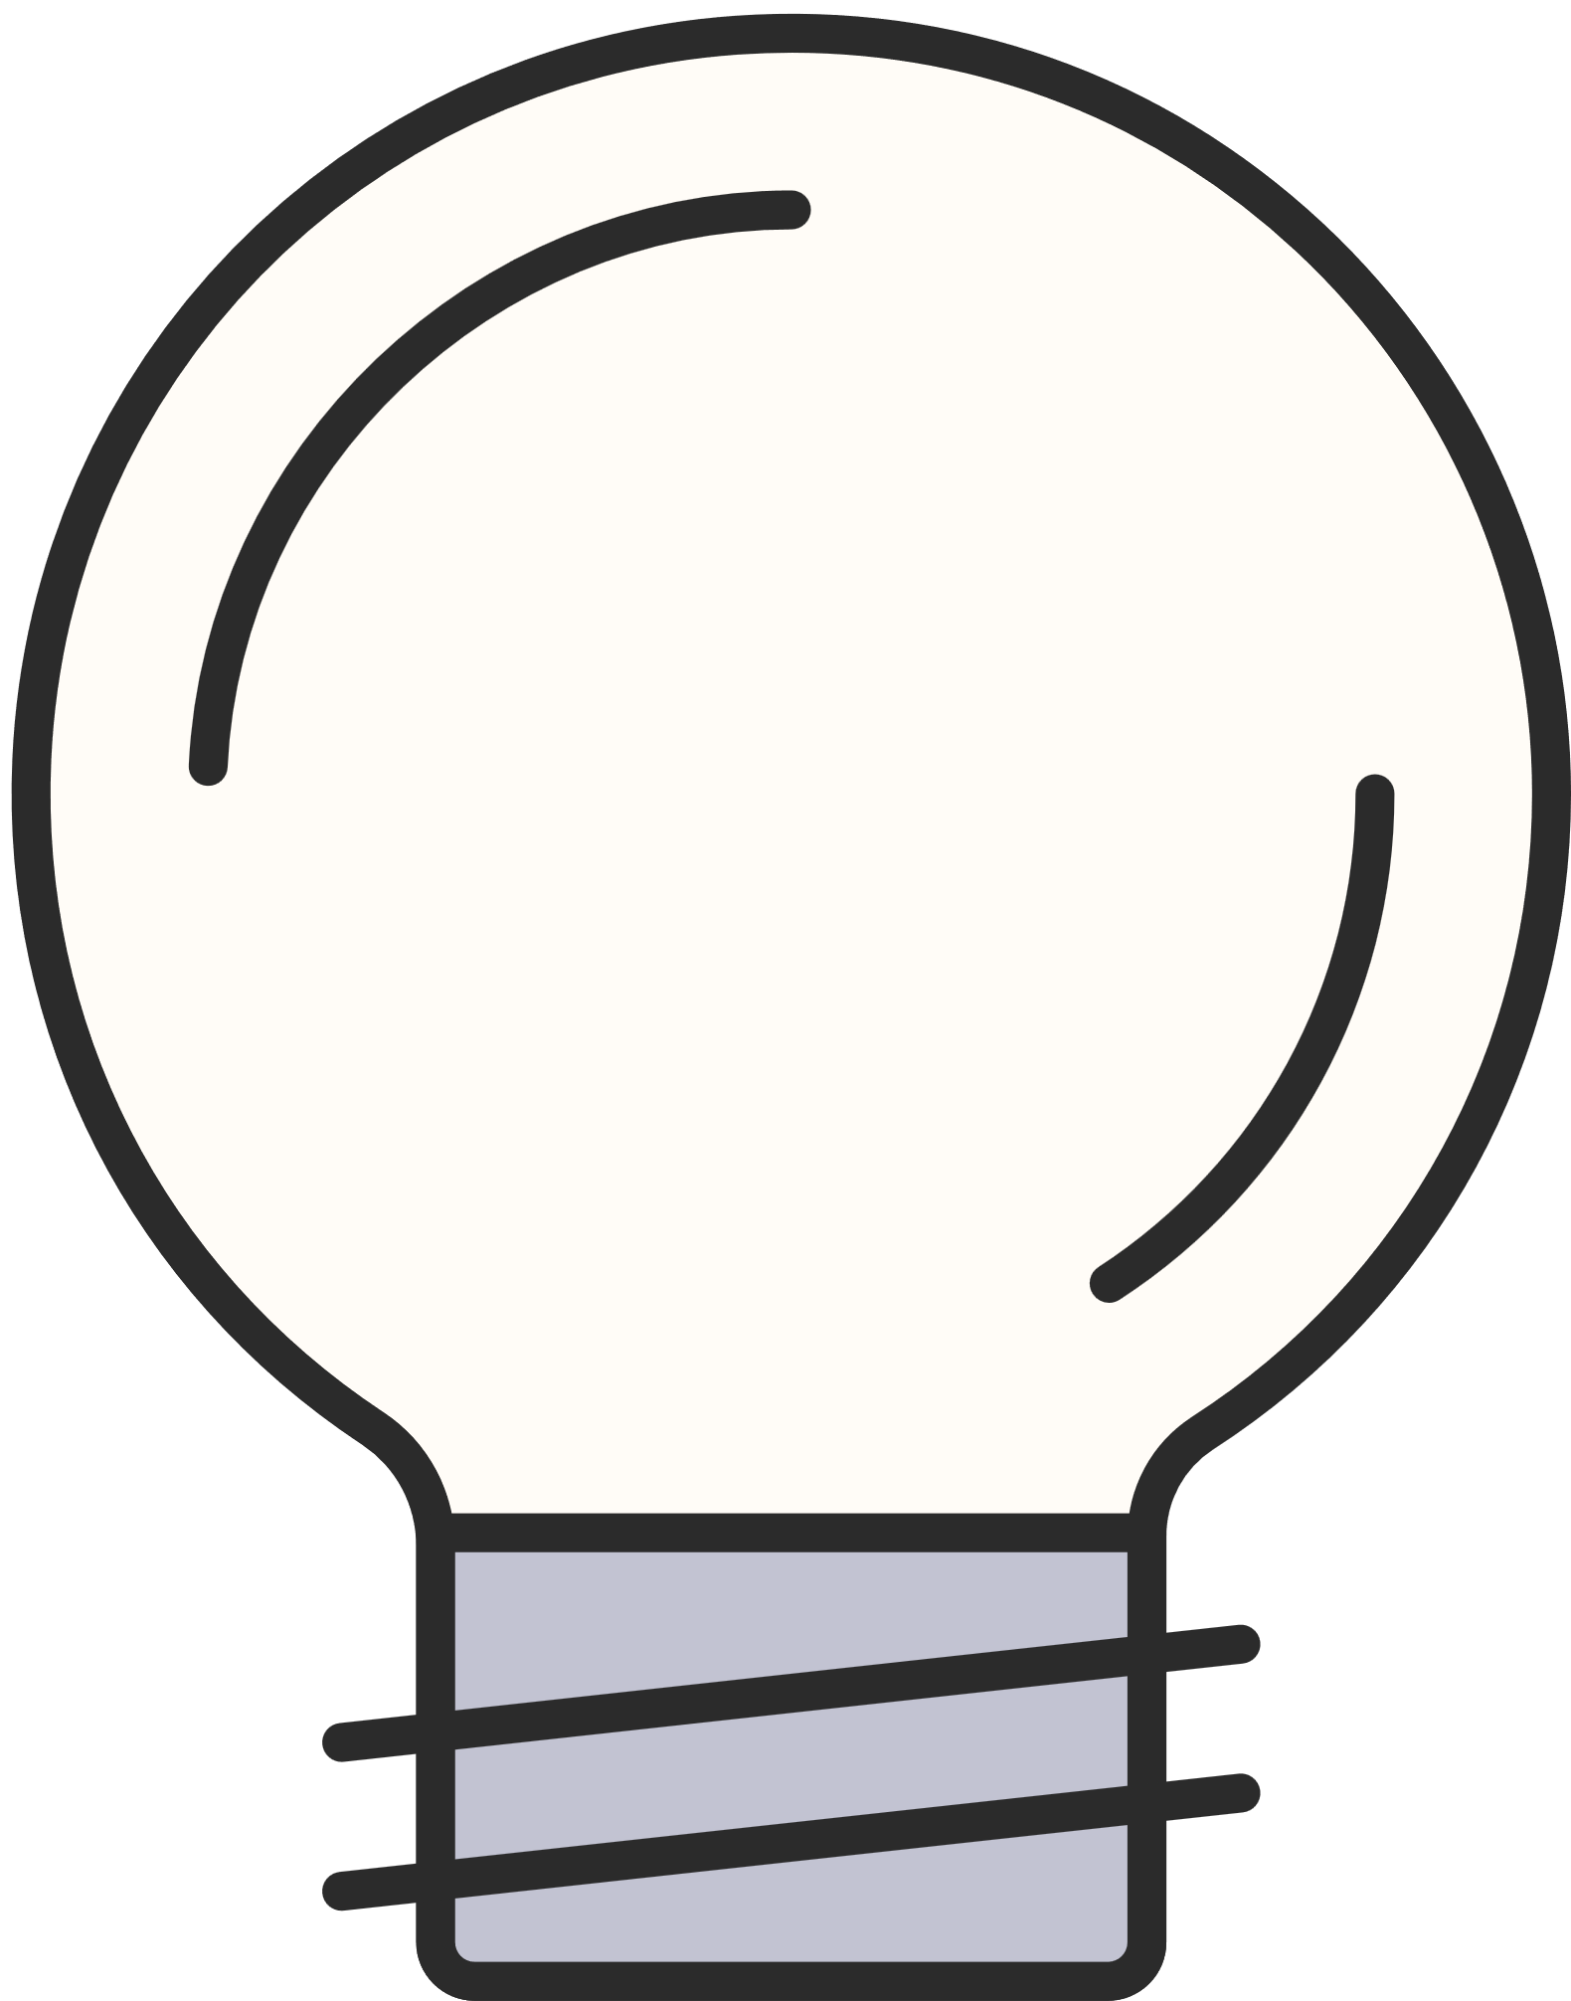




Automated MRI report analysis
Custom rehabilitation plans
using OCR and OpenAI language models for accurate injury insights.
Tailored by doctors and updated dynamically with a smart scheduling algorithm
Key Feautres
Exercise
guidance
AI-powered injury prevention plans
Detailed visuals and real-time posture correction using MediaPipe
tailored to each user’s physical profile and risk factors

Slide 9
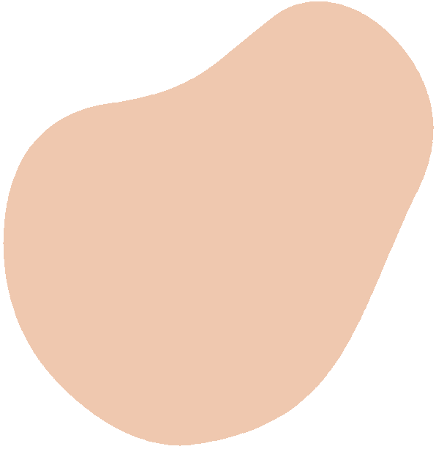





Multi-tier design separating UI, logic, and data.
Frontend: Flutter & Dart for cross-platform UI.
System Architecture
Backend: Firebase for real-time DB, authentication, AI cloud functions.
Highlights scalability, security, and responsive UI design.

Slide 10
Models

Slide 11
Extracts text from medical reports.
Text Extraction Model
Preprocess the uploaded Image to be ready for text extraction
OCR for Text Extraction
Converts image to readable text and passes to NLP stage.
Uses the Extracted Data and send it using API to OpenAI for accurate classification

Slide 12
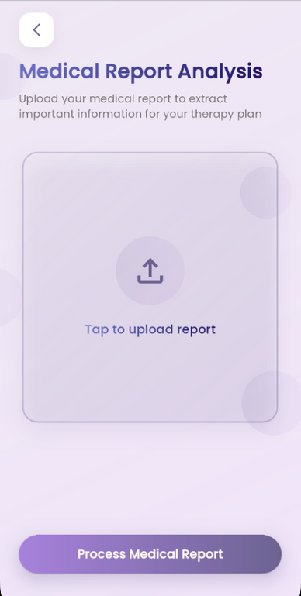
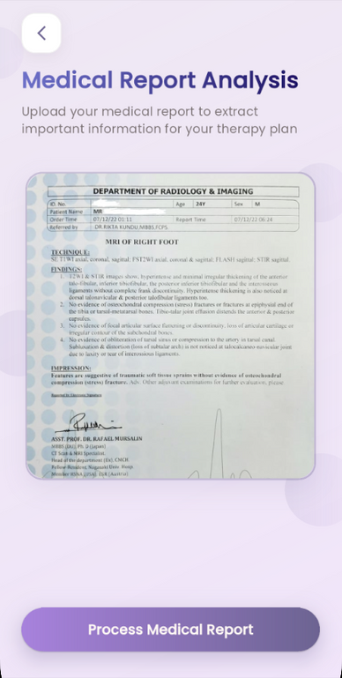
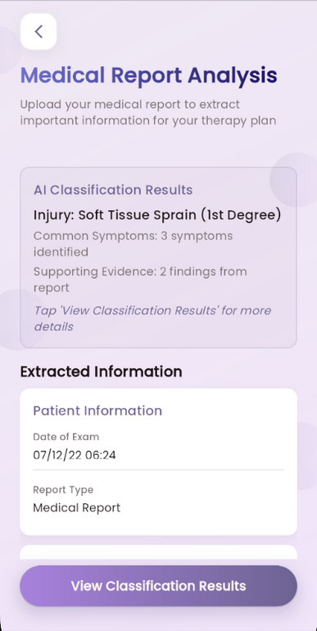
Classify Injury
Upload
Process
Classify
Result
Start your assessment to by Uploading your Medical Report
Processing your Medical Report to Extract the Useful Information
Showing the Extracted Information to the user for Verfication
Classifying the extracted information

Slide 13
Assigns users to one of 7 fitness levels.
Personalized Prevention Plan Model
Uses Deep Neural Network (DNN).
DNN for generating personalized plan
Inputs: Age, gender, weight, height
Performance:
  Accuracy: 87.4%
  Weighted F1: 87.18%

Slide 14
Real-time movement feedback during exercises.
Pose Estimation Model
Uses MediaPipe Pose Estimation Model
MediaPipe Pose Estimation
  Tracks user joints
  compares to ideal poses
  provides correction.
For Injury prevention & ensuring correct form during exercises.

Slide 15
Diagrams

Slide 16
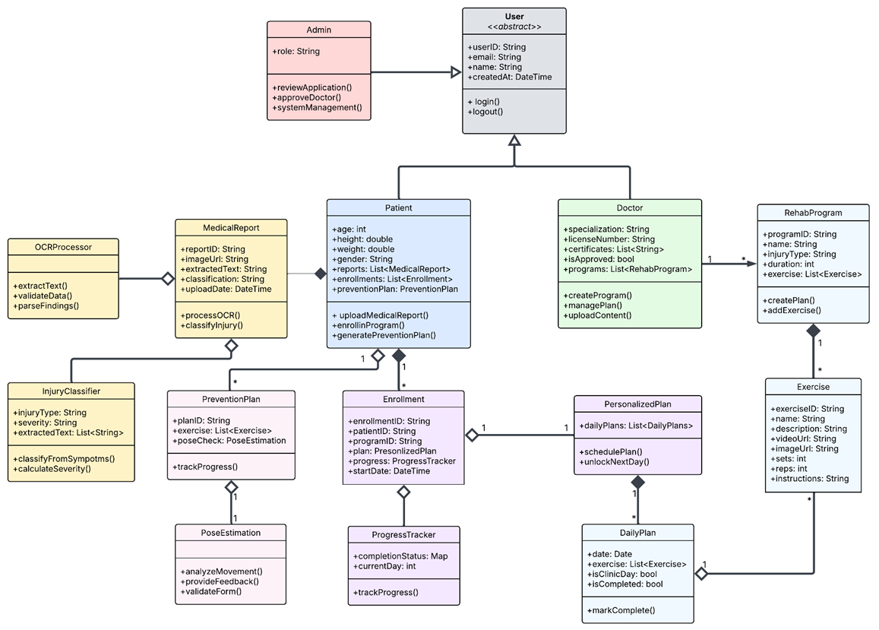
Class Diagram
Diagram 3

Slide 17
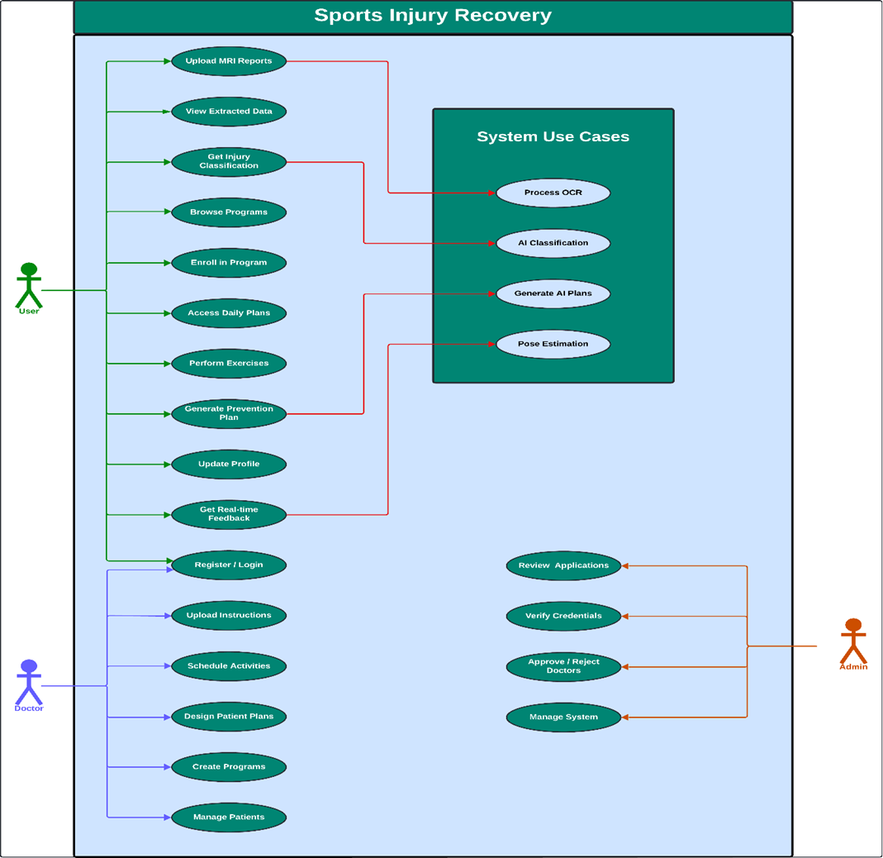
Diagram 2
Use Case Diagram

Slide 18
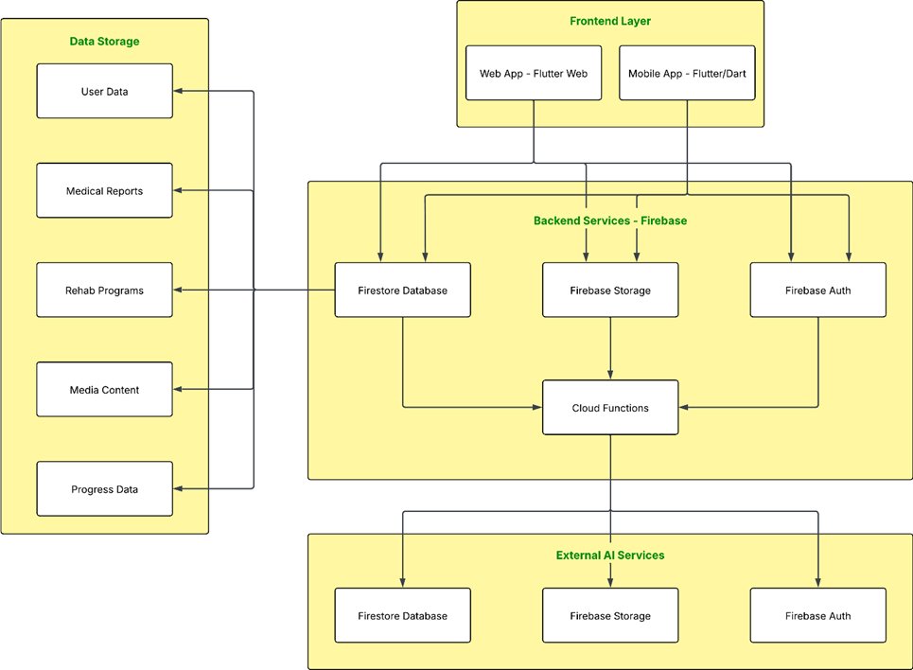
System Architecture Diagram
Diagram 3

Slide 19
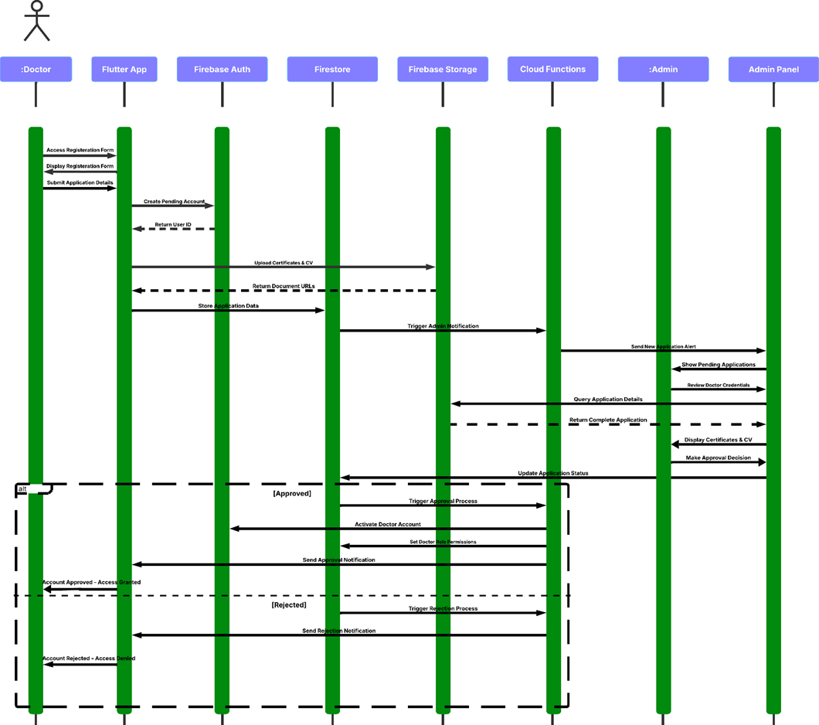
Doctor Registration
Diagram 4
Sequence Diagram 1

Slide 20
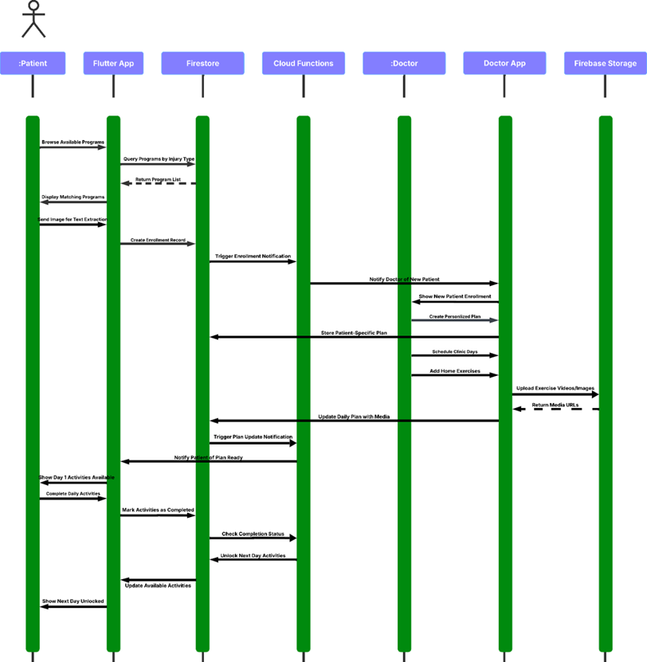
Rehabilitation Management
Diagram 5
Sequence Diagram 2

Slide 21
Conclusion

Slide 22
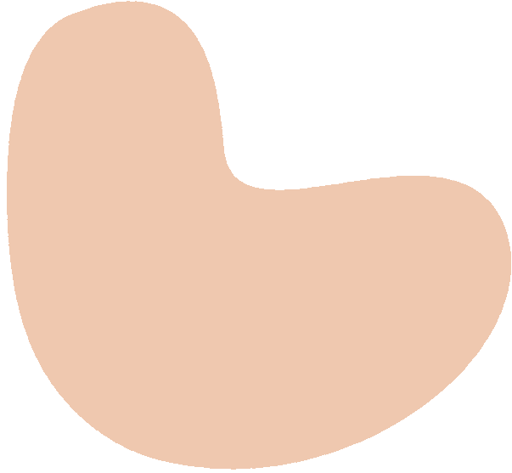
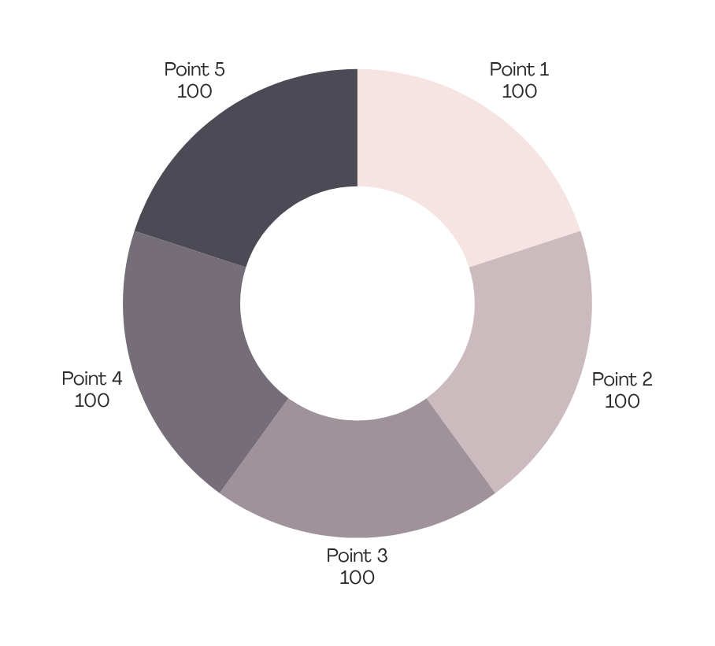
  Developed an AI-powered digital health platform
  Integrated OCR, NLP, and OpenAI models
  Introduced personalized injury prevention plan
  Enabled physician-supervised digital rehab plans
  Demonstrated a scalable framework that can extend to other medical fields.

Slide 23
Future Work

Slide 24
Expand the platform to cover all major musculoskeletal conditions
Integrate AI-powered pose estimation into all strengthening exercises
Future Work
Achieve fully autonomous supervision using advanced computer vision
Evolve into a scalable, publication-ready, and commercially viable digital health ecosystem.

Slide 25
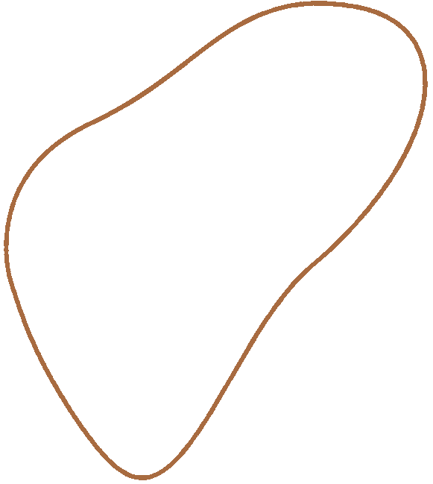
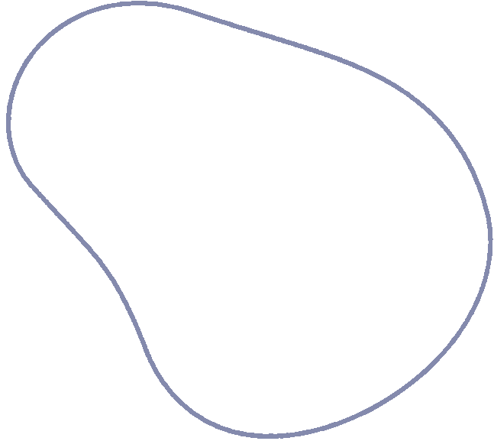
Thank you!

